Slide 1
Terminology and Concepts
MySQL | MongoDB
Table | Collection
Row | Document
Column | Field

Slide 2
MongoDB
open-source database developed by MongoDB, Inc.
NoSQL Database
stores data like
fast query access
dynamic schemas

Slide 3
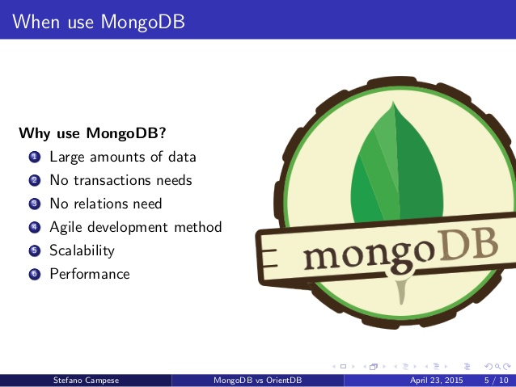

Slide 4
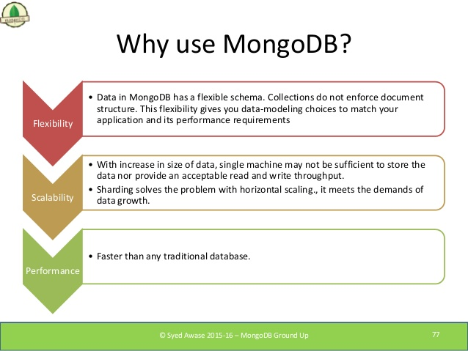

Slide 5
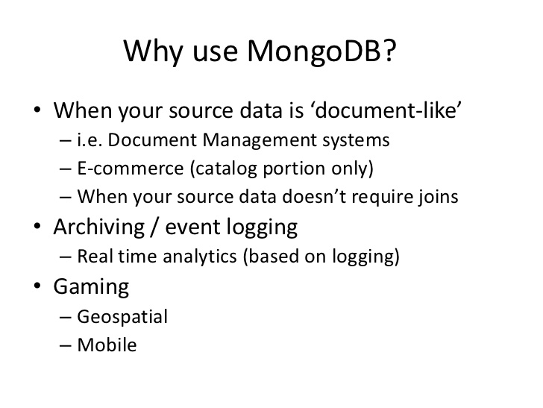

Slide 6
Feature Comparison
 | MySQL | mongoDB
Rich Data Model | No | Yes
Dynamic Schema | No | Yes
Typed Data | Yes | Yes
Field Updates | Yes | Yes
Easy for Programmers | No | Yes
Complex Transactions | Yes | No
Auditing | Yes | Yes

Slide 7
Install MongoDB (https://www.mongodb.com/download-center?jmp=nav#community )
Component Set | Binaries
Server | mongod.exe
Router | mongos.exe
Client | mongo.exe
MonitoringTools | mongostat.exe, mongotop.exe
ImportExportTools | mongodump.exe, mongorestore.exe, mongoexport.exe, mongoimport.exe
MiscellaneousTools | bsondump.exe, mongofiles.exe, mongooplog.exe, mongoperf.exe

Slide 8
Run mongoDB
Set up the MongoDB environment
MongoDB requires a data directory to store all data. You can specify an alternate path for data files using the --dbpath option to mongod.exe, for example:
"C:\Program Files\MongoDB\Server\3.4\bin\mongod.exe" --dbpath “d:\xavientPOC\mongodb\data”

Slide 9
Using configuration file
Open an Administrator command prompt.
Create directories. (D:\xavientPOC\mongoDB\db, d:\xavientPOC\mongoDB\\log ).
Create a configuration file at C:\Program Files\MongoDB\Server\3.4\mongod.cfg
that specifies both systemLog.path and storage.dbPath:
systemLog:
destination: file
path: d:\xavientPOC\mongoDB\log\mongod.log
storage:
dbPath: d:\xavientPOC\MongoDB\data\db

Slide 10
6. Install the MongoDB service.
"C:\Program Files\MongoDB\Server\3.4\bin\mongod.exe" --config "C:\Program Files\MongoDB\Server\3.4\mongod.cfg" --install
7. Start the MongoDB service.
net start MongoDB
8. Stop the MongoDB service.
net stop MongoDB

Slide 11
Manually Create a Windows Service for MongoDB
sc.exe create MongoDB binPath= "\"C:\Program Files\MongoDB\Server\3.4\bin\mongod.exe\" --service --config=\"C:\Program Files\MongoDB\Server\3.4\mongod.cfg\"" DisplayName= "MongoDB" start= "auto“
sc.exe delete MongoDB

Slide 12
Start MongoDB (server)
To start MongoDB, run mongod.exe. For example, from the Command Prompt:
"C:\ProgramFiles\MongoDB\Server\3.4\bin\mongod.exe"
Connect to MongoDB(client)
To connect to MongoDB through the mongo.exe shell, open another Command Prompt.
"C:\Program Files\MongoDB\Server\3.4\bin\mongo.exe

Slide 13
mongoDB CRUD Operation Create Operations
Create or insert operations add new documents/row to a collection/table. If the collection does not currently exist, insert operations will create the new collection/table.
_id Field
In MongoDB, each document stored in a collection requires a unique _id field that acts as a primary key.
Atomicity
All write operations in MongoDB are atomic on the level of a single document

Slide 14
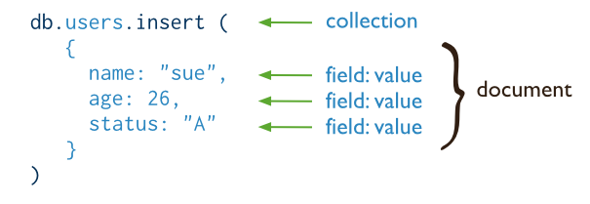
db.collection.insert()
db.collection.insertOne() New in version 3.2
db.collection.insertMany() New in version 3.2

Slide 15
1. db.users.insert(
{
name: "anil", age: 26, status: "A"
}
)
2. db.users.insertOne(
{
name: "Ravi", age: 26, status: "A"
}
)
3. db.users.insertMany(
[
{ name: "Manish", age: 29, status: "A", },
{ name: "Satish", age: 27, status: "A", },
{ name: "Harsh", age: 22, status: "D", }
]
)

Slide 16
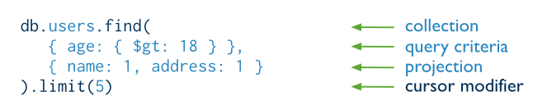
Read Operations
Read operations retrieves documents from a collection; i.e. queries a collection for documents.

Slide 17
db.users.find( { status: "A" } )
db.users.find( { age: { $lt: 30 } }, {status: ""} )
. db.users.find(
{ age: { $gt: 18 } },
{ name: "" , age: ""} )
AND condition:
db.users.find( { status: "A", age: { $lt: 30 } } )
OR condition:
db.users.find(
{ $or: [ { status: "A" }, { age: { $lt: 30 } } ] }
)
In condition
db.users.find( { status: { $in: [ "P", "D" ] } } )
AND & OR
db.users.find(
{ status: "A",
$or: [ { age: { $lt: 30 } }, { name: "manish" } ] }
)

Slide 18
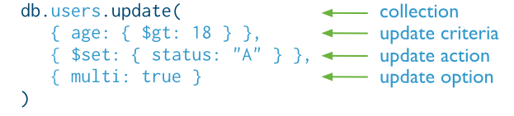
Update Operations
Update operations modify existing documents in a collection.
db.collection.update()
db.collection.updateOne() New in version 3.2
Updates at most a single document that match a specified filter even though multiple documents may match the specified filter
db.collection.updateMany() New in version 3.2

Slide 19
Delete Operations
remove all documents from a collection
db.users.deleteMany({})or db.users.remove({})
To delete at most a single document that match a specified filter
db.users.deleteOne( { status: "D" } ) Or db.users.remove( { status: "D" }, 1)

